Slide 1
MODULE 2 ..PART4..IRS INFORMATION RETRIEVAL MODELS
I
1) covered till date
1.1) boolean classic model….simple,set theory,boolean expression, exact matching, no ranking, binary index terms
1.2)partial matching, nonbinary weights in range from 1 to 0, cosine ranking formula,
1.3) probabilistic model..creates relevant and illevant document set, frequency of relevance,
1.4) Alternate set theory models….two types… fuzzy set model and extended boolean model
1.5) fuzzy set model …. multiple truth values , set of relevant documents……

Slide 2
MODULE 2 ..PART4..IRS INFORMATION RETRIEVAL MODELS
I
1) covered till date……cont
1.5) …..called as fuzzy set can be represented from 1 to 0 , indexing is called description, The membership function is associated with each class, Thesaurus is performed-term-term correlation matrix , correlation factor Ci.l
1.6)extended boolen model…. simplicity of the boolean model, partial matching, weighting for indexing

Slide 3
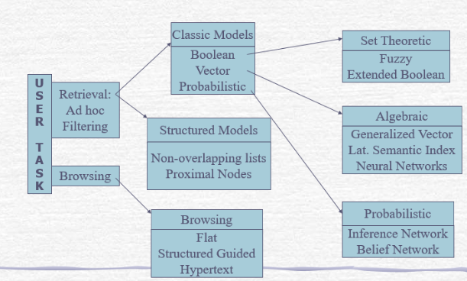
MODULE 2 ..PART4..IR MODELS
(1)taxonomy of Information retrieval system

Slide 4
MODULE1 ..PART4..IR MODEL
2) alternative probabilistic IR models
2.1)this model uses the Bayesian(belief) network
2.2)It works on the principles of containing various sources of evidences like past queries, past feedback cycles and different query formation
2.3) this combination of different evidence sources improve the retrieval performance i.e the quality of the retrieval document
2.4)The models to be discussed are….interference network Bayesian model and belief network bayesian model
.

Slide 5
MODULE1 ..PART4..IR MODEL
2) alternative probabilistic IR models
Past queries
Inference network
Past feedback cycle
Performance measure of
Belief network
Different query formations

Slide 6
MODULE1 ..PART4..IR MODEL
2) alternative probabilistic IR models…. Bayesian network
A Bayesian network (BN) is a probabilistic graphical model for representing knowledge about an uncertain domain where each node corresponds to a random variable and each edge represents the conditional probability for the corresponding random variables these networks are also called belief networks
F1(x1,Tx1) F2(Tx2,Tx1)
F3(x2,Tx2)
Tx1
G : the Bayesian network
Xi be the nodes in the Bayesian network G,
Xi where I:1,2,3,4, (X1,X2.X3.X4)
Txi be the set of parent nodes
Where Txi:1,2 (Tx1,Tx2)
(Xi will be the child node,X1,X2
X1
Tx2
X2

Slide 7
MODULE1 ..PART4..IR MODEL
3) Representation of Bayesian network…cont
3.1)Let G be the Bayesian network formed, let Xi be the nodes in the Bayesian network G, Txi be the set of parent nodes of Xi (Xi will be the child node)
3.2)The root node or the first parent node Txi will have some effect on its child node or child nodes (Xi) and this causal relationship is represented in a form of directed graph from the parent node to the child node with a function Fi as Fi(Xi, Txi)
3.3)The root node does not have any parents
3.4) Then the child node if produces their effects on other nodes then the child node becomes the parent node and the causal relationship between the next parent node and their child node is further represented with directed graph

Slide 8
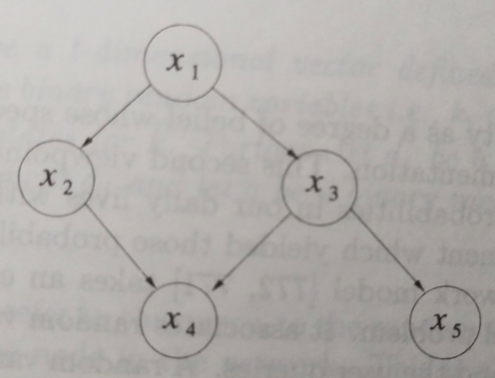
MODULE1 ..PART4..IR MODEL
3.5)consider,….
a) let X1, X2, X3, X4 and X5 be the nodes Xi
b) X1 is the root node( node with no parent node)
c) X2 and X3 are its two child nodes of Xi where the causal relationship between them is represented as a directed graph as
d) P(X2/X1) and P(X3/X1) were P stands for the probability distribution
e) X2 and X3 now the parent nodes for child node X4,

Slide 9
MODULE1 ..PART4..IR MODEL
3.5)consider,….cont
f) This causal relationship is represented as
P(X4/X2.X3)
g) Similarly the casual relationship between parent node X3 and its child node X5 is P{X5/X3)
h) The joint probability distribution
i) P(X1,X2,X3,X4,X5) is represented as……
P(X1)P(X2/X1)P(X3/X1)P(X4/X2.X3)P(X5/X3)

Slide 10
MODULE1 ..PART4..IR MODEL
4) Bayesian network types….
4.1) inference network model….
a)In case of probability, we can get the statistical information which can be used. But if the statistical data is not present then data by belief is selected as it is not possible to get experimental statistical data every time
b) The inference network model uses the belief data for information retrieval
c) Random variables are associated with both the documents and queries
d) The variable associated with the document represents the event of observing the document i.e the document is also searched by other queries along with its own
e) Thus it increases the belief in the index term that the document will be selected

Slide 11
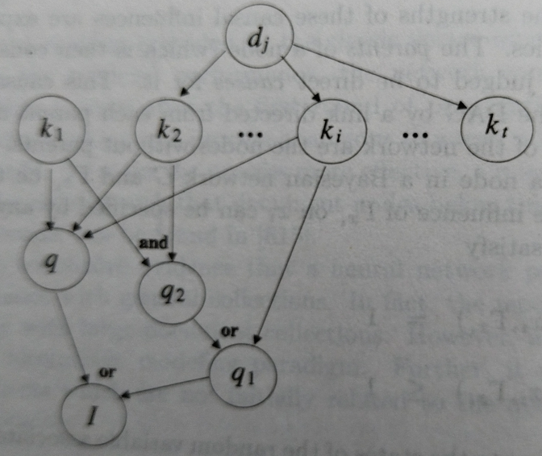
MODULE1 ..PART4..IR MODEL
4) Bayesian network types….
4.2) inference network model….working
a)Dj is the document,
b)the index terms in the document which represents the description are K1, K2 and Ki
c)Now query Q is fired which in indexed and have a matching with its index terms K1, K2and Ki
d)Thus directed graph from Dj to k1,k2 k3

Slide 12
MODULE1 ..PART4..IR MODEL
4) Bayesian network types….
4.2) inference network model….working
e)the query q has a matching with document index terms K1,K2 and Ki thus a directed graph from K1,K2 and Ki to q
f) Now query q is supported by additional queries Q1, Q2 and I.were
g) q2supports both K1 and K2
h) q1 support Ki or query q2 i.e k1 and k2

Slide 13
MODULE1 ..PART4..IR MODEL
4) Bayesian network types….
4.3)belief network model
a)It works on the interpretation of the probabilities…on belife
b)All documents Dj are indexed with index terms K1…Ki,
c) the set K of all index terms will be K=(K1…Ki), K is the probability space
d)The probability distribution P is thus defined over set K as P(c) were P (c) is the degree of convergence of the space K
e)Working…
e.1)If the user query Q, and K=(K1…Ki) is the probability space and if query Q satisfies all the condition of K then Q will be in its probability space and random variable assigned to it will be 1 thus P(K) is 1

Slide 14
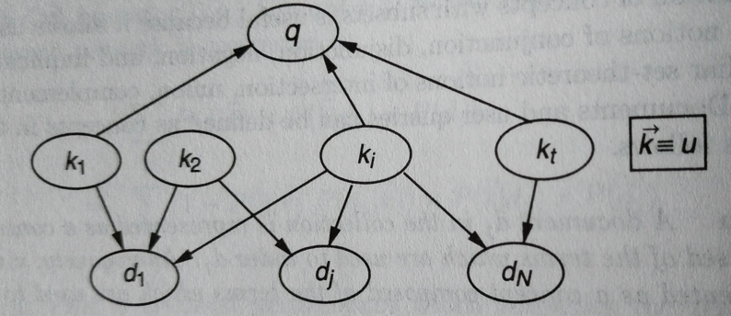
MODULE1 ..PART4..IR MODEL
4) Bayesian network types….
4.3)belief network model
e)Working…
e.2)similarly when P(Dj) is found to be 1 i.e the document Dj also satefies all the condition of the probability space then P(Dj) =1
As per the diagram, q is the query, K1,K2,Ki Kt are the index terms of probability space
D=(D1,Dj Dn) are all the documents

Slide 15
MODULE1 ..PART4..IR MODEL
5)Structured text retrieval IR models
5.1)The users query is called as the text contents are specifications of strings 5.2) from the document side the patterns are the specification of structured components of the document
5.3) this model basically combine the text information of query with the structured information of the documents
5.4) basically it works at the data level and not information
5.5) matching point is the term used for the position of words or it sequence which matches the user query
5.6) if user gives query as set of words and these words match in three places in document Dj then there are three matching points

Slide 16
MODULE1 ..PART4..IR MODEL
5)Structured text retrieval IR models
5.6) if user gives query as set of words and these words match in three places in document Dj then there are three matching points
5.7) if the document has a paragraph or section matching with query set of words then it defines a region
5.8) types…..model based on non overlapping lists and model based on proximity nodes
5.8.a) model based on non overlapping list
a)The entire text of the document is divided into non overlapping text regions and collected together as list.
b) Asingle document can be divided into four such regions like …

Slide 17
MODULE1 ..PART4..IR MODEL
5)Structured text retrieval IR models
Non overlapping
User query
(specification of string)
Nonoverlapping
model
Document as region
Region1:chapter
Region2:Page
Region3;Paragraph
Region2; line:
Compared based on type of structured model
Proximity nodes
Document
(specification of structural component )
Proximity model

Slide 18
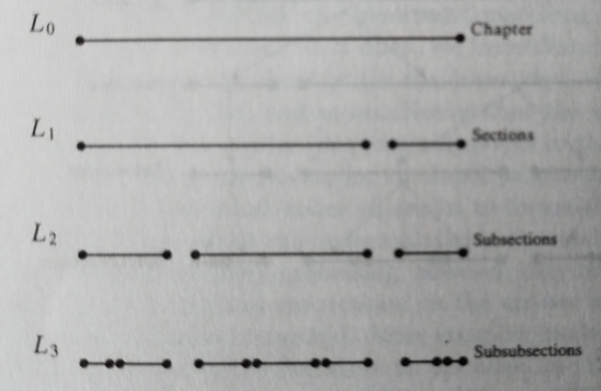
MODULE1 ..PART4..IR MODEL
5)Structured text retrieval IR models
5.8.a) model based on non overlapping list

Slide 19
MODULE1 ..PART4..IR MODEL
5)Structured text retrieval IR models
5.8.b) model based on proximal nodes
a) Independent hierarchical Indexed structures are made which can be of chapter sections, pages, lines.
b)Each of these is called as a nodes
c) Each node associates a text region in the document
d) Two such node hierarchies will represent nonoverlapping regions in the text region of the document
f)User gives a text query, what is retrieved from document will be one type of node hierarchy structure.

Slide 20
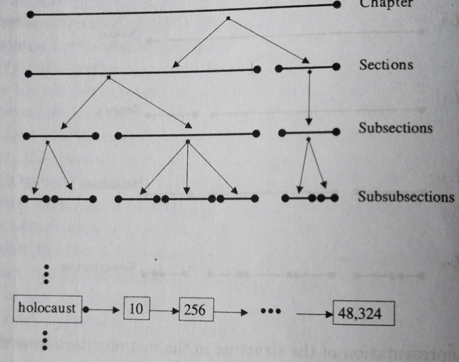
MODULE1 ..PART4..IR MODEL
5)Structured text retrieval IR models
5.8.b) model based on proximal nodes
g)This allows independent hierarchical indexing ststructuresver the same document.
h) Each such hiereachical structure consist of chapters,sections, paragraphs, pages and lines ,
i) These are called as nodes associated with a text region
j) working…….

Slide 21
MODULE1 ..PART4..IR MODEL
5)Structured text retrieval IR models
5.8.b) model based on proximal nodes
j) working…….
j.1) holocaust is the query word to be checked in the document
j.2) the arrow indicates the marking of this word in a hierarchical structure i.e in the chapter within sections,then subsection and so on

Slide 22
MODULE1 ..PART4..IR MODEL
6) models for browsing
6.1)This is a process were the user task is not selecting something but just searching
6.2) there are three types of browsing-flat, structure-guided and hypertext
6.3) flat browsing….
a)The user searches the document list so as to select the documents for further query formation.
b) The can search the selected document to find what he wants
c)like yahoo, which provides documents for search
6.4) structure guided browsing…..
a) Their can be classes of documents were the classes are arranged in it in a….

Slide 23
MODULE1 ..PART4..IR MODEL
6) models for browsing
6.4)structure guided browsing…..
a)……Hierarchical manner
b) Due to this the document selection becomes more easy as the are arranged in a directory form
6.5) hypertext model…..
a)When then search is done with the query sometimes we may be interested in some information which is not selected by those keywords
b)For eg the query is war, so searching for war we may only be intereseted only in dates then hypertext t document for dates is generated which my or may not be required ,

Slide 24
MODULE1 ..PART3..IRS
Thank You

